Slide 1

Recursion
Introduction to Stack
Recursion is a process by which a function calls itself repeatedly, until some specified condition has been satisfied
The process is used for repetitive computations in which each action is stated in terms of a previous result.
To solve a problem recursively, two conditions must be satisfied.
First, the problem must be written in a recursive form
Second the problem statement must include a stopping condition

Slide 2
Types of Recursions: Recursion are mainly of two types depending on whether a function calls itself from within itself or more than one function call one another mutually. The first one is called direct recursion and another one is called indirect recursion. fun() { ------------- ------------ ---------- fun() }
Introduction to Stack
Fun1()
{
Fun2()
}
Fun2()
{
Fun1()
}

Slide 3
Introduction to Stack
Head Recursion()
Fun()
{
Fun();
…….
……
…….
}
Tail Recursion()
Fun()
{
…….
……
…….
Fun();
}
Head &Tail Recursion()
Fun()
{
Fun()
...….
……
…….
Fun();
}

Slide 4
Recursion
Introduction to Stack
There is base condition, that stops further calling of the function
Function call itself directly or indirectly, it should reach towards base condition.

Slide 5
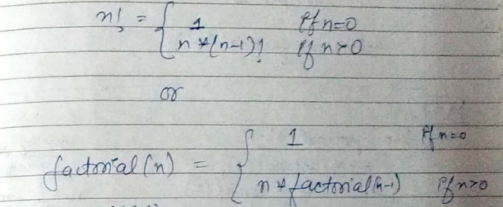
Calculate Factorial of the number using Recursion.
Introduction to Stack
factorial of n → (n!) = n * n-1 – n-2* ………*2*1
n!= n* (n-1)! And 0! = 1

Slide 6
Factorial of an integer number using recursive function
Introduction to Stack
def recur_factorial(n):
if n == 1:
return n
else:
return n*recur_factorial(n-1)
Factorial(5)=
5*Factorial(4)=
5*(4*Factorial(3))= 5*(4*(3*Factorial(2)=
5*(4*(3*(2*Factorial(1))))=
5*(4*(3*(2*(1*Factorial(0)))))=
5*(4*(3*(2*(1*1))))= 5*(4*(3*(2*1)))=
5*(4*(3*2))= 5*(4*6)= 5*24=
num = int(input("Enter the number: "))
# check if the number is negative
if num < 0:
print("Sorry, factorial does not exist for negative numbers")
elif num == 0:
print("The factorial of 0 is 1")
else:
print("The factorial of", num, "is", recur_factorial(num))
120

Slide 7
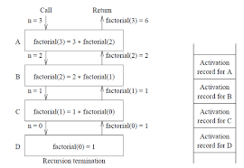
Factorial of an integer number using recursive function
Introduction to Stack
def recur_factorial(n):
if n == 1:
return n
else:
return n*recur_factorial(n-1)
num = int(input("Enter the number: "))
# check if the number is negative
if num < 0:
print("Sorry, factorial does not exist for negative numbers")
elif num == 0:
print("The factorial of 0 is 1")
else:
print("The factorial of", num, "is", recur_factorial(num))

Slide 8
Recursion
Program for Fibonacci numbers
The Fibonacci numbers are the numbers in the following integer sequence.
0, 1, 1, 2, 3, 5, 8, 13, 21, 34, 55, 89, 144, ……..
In mathematical terms, the sequence Fn of Fibonacci numbers is defined by the recurrence relation Fn = Fn-1 + Fn-2 with seed values F0 = 0 and F1 = 1.

Slide 9
Recursion
def fib_num(n):
if n<=0:
print("Fibonacci can't be computed")
# First Fibonacci number
elif n==1:
return 0
# Second Fibonacci number
elif n==2:
return 1
else:
return fib_num(n-1)+fib_num(n-2)
#input
n=int(input("Enter n: "))
print("{}th Fibonacci number is ".format(n),fib_num(n))

Slide 10
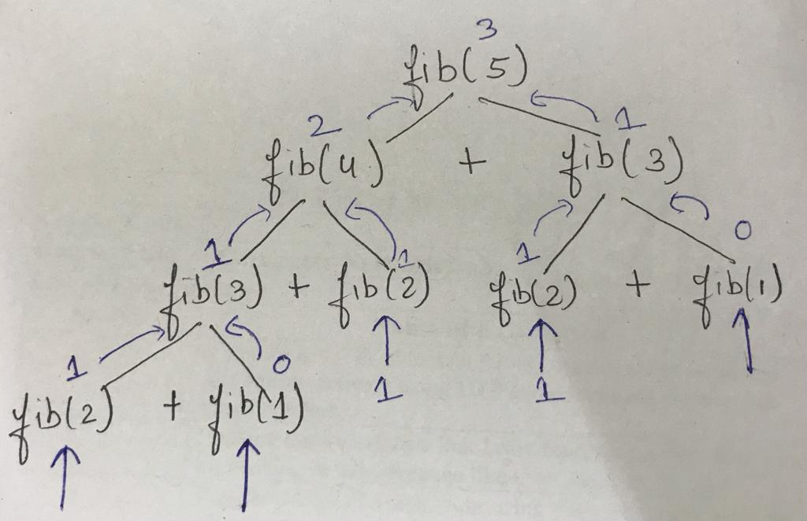
Recursion

Slide 11
Recursion Pros and Cons
Introduction to Stack
Pros
The code may be much easier to write.
To solve some problems which are naturally recursive such as tower of Hanoi.
Cons
Recursive functions are generally slower than non-recursive functions.
May require a lot of memory to hold intermediate results on the system stack.
It is difficult to think recursively so one must be very careful when writing
recursive functions.

Slide 12
Recursion

Slide 13
Recursion
Binary Search Using Recursion
def binary_search(my_list, low, high, elem):
if high >= low:
mid = (high + low) // 2
if my_list[mid] == elem:
return mid
elif my_list[mid] > elem:
return binary_search(my_list, low, mid - 1, elem)
else:
return binary_search(my_list, mid + 1, high, elem)
else:
return -1

Slide 14
Recursion
my_list = [ 1, 9, 11, 21, 34, 54, 67, 90 ]
elem_to_search = 1
print("The list is")
print(my_list)
my_result = binary_search(my_list,0,len(my_list)-1,elem_to_search)
if my_result != -1:
print("Element found at index ", str(my_result))
else:
print("Element not found!")

Slide 15
Tower of Hanoi Problem
Introduction to Stack
Tower of Hanoi is a mathematical puzzle where we have three rods and n disks.

Slide 16
Tower of Hanoi Problem
Introduction to Stack
The objective of the puzzle is to move the entire stack to another rod, obeying the following simple rules:
Only one disk can be moved at a time.
2) Each move consists of taking the upper disk from one of the stacks and placing it on top of another stack i.e. a disk can only be moved if it is the uppermost disk on a stack.
3) No disk may be placed on top of a smaller disk.

Slide 17
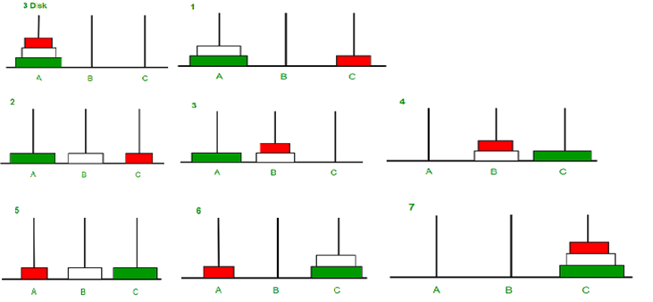
Tower of Hanoi Problem Illustration
Introduction to Stack

Slide 18
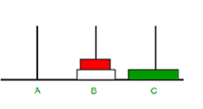
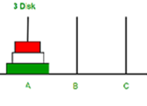
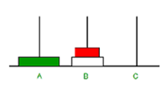
Tower of Hanoi Algorithm Concept
Introduction to Stack

Slide 19
A recursive algorithm for Tower of Hanoi can be driven as follows
Introduction to Stack
def TowerOfHanoi(n , source, destination, auxiliary):
if n==1:
print ("Move disk 1 from source",source,"to destination",destination)
return
TowerOfHanoi(n-1, source, auxiliary, destination)
print ("Move disk",n,"from source",source,"to destination",destination)
TowerOfHanoi(n-1, auxiliary, destination, source)
# Driver code
n = 3
TowerOfHanoi(n,'A','B','C')
# A, C, B are the name of rods

Slide 20
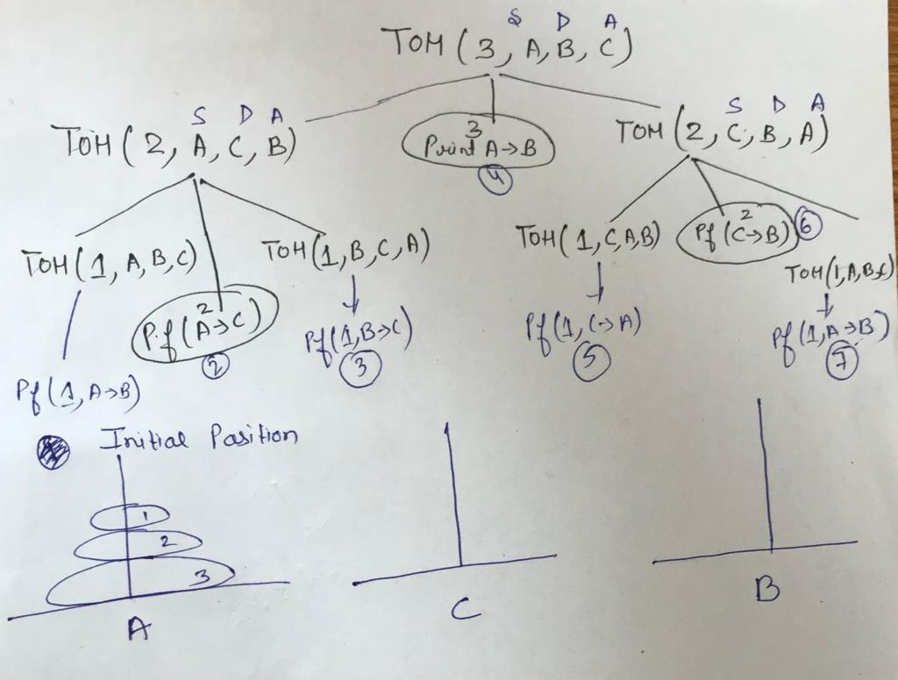
Introduction to Stack
Recursive Tree

Slide 21
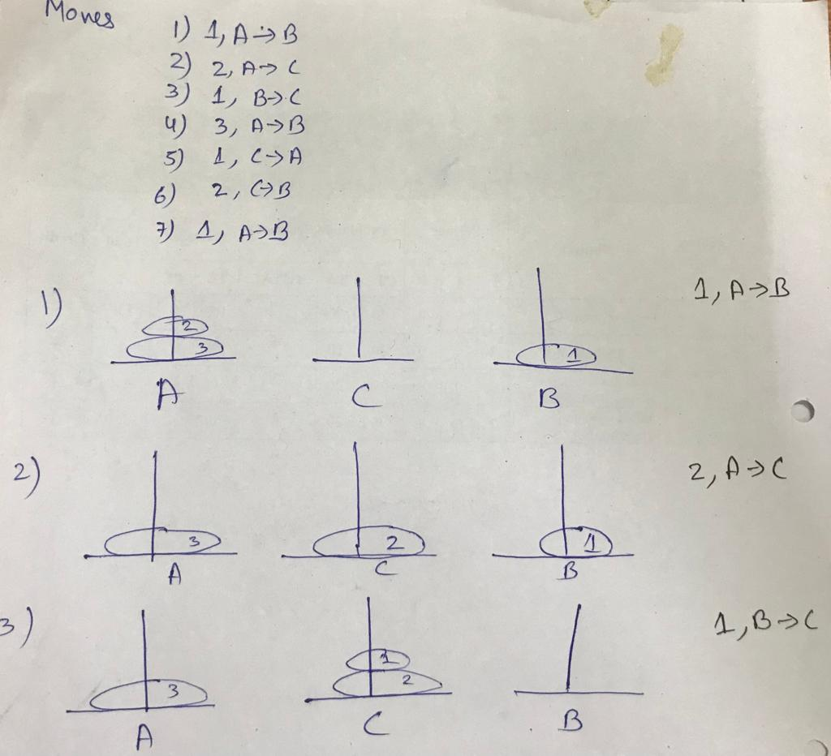
Introduction to Stack

Slide 22
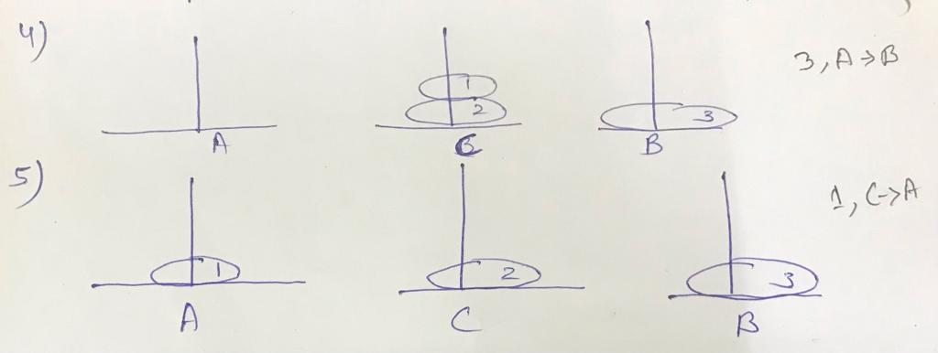
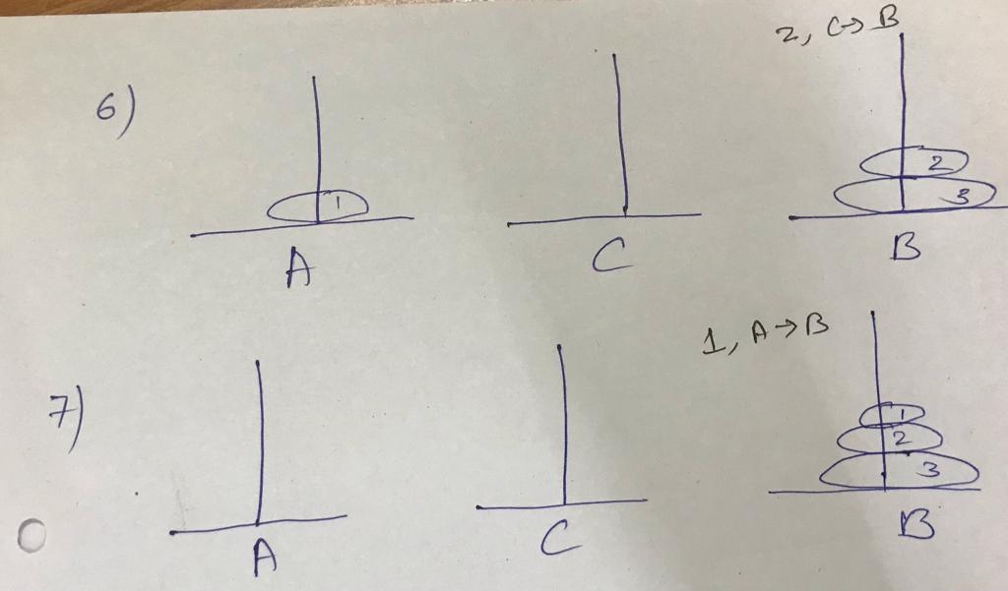
Introduction to Stack

Slide 23
Recursion
Difference Between Recursion and Iteration
BASIS FOR COMPARISON | RECURSION | ITERATION
Basic | The statement in a body of function calls the function itself. | Allows the set of instructions to be repeatedly executed.
Format | In recursive function, only termination condition (base case) is specified. | Iteration includes initialization, condition, execution of statement within loop and update (increments and decrements) the control variable.
Termination | A conditional statement is included in the body of the function to force the function to return without recursion call being executed. | The iteration statement is repeatedly executed until a certain condition is reached.

Slide 24
Recursion
Difference Between Recursion and Iteration
BASIS FOR COMPARISON | RECURSION | ITERATION
Condition | If the function does not converge to some condition called (base case), it leads to infinite recursion. | If the control condition in the iteration statement never become false, it leads to infinite iteration.
Infinite Repetition | Infinite recursion can crash the system. | Infinite loop uses CPU cycles repeatedly.
Applied | Recursion is always applied to functions. | Iteration is applied to iteration statements or "loops".
Stack | The stack is used to store the set of new local variables and parameters each time the function is called. | Does not uses stack.
Overhead | Recursion possesses the overhead of repeated function calls. | No overhead of repeated function call.

Slide 25
Recursion
Difference Between Recursion and Iteration
BASIS FOR COMPARISON | RECURSION | ITERATION
Speed | Slow in execution. | Fast in execution.
Size of Code | Recursion reduces the size of the code. | Iteration makes the code longer.

